Slide 1
^{Oxford Global Languages} ^{A defining project}
8th Global WordNet Conference ^{Bucharest 28th January 2016}
Jon French| Advocacy and Partnerships Manager

Slide 2
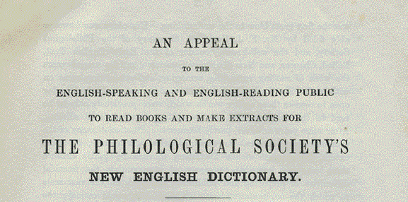
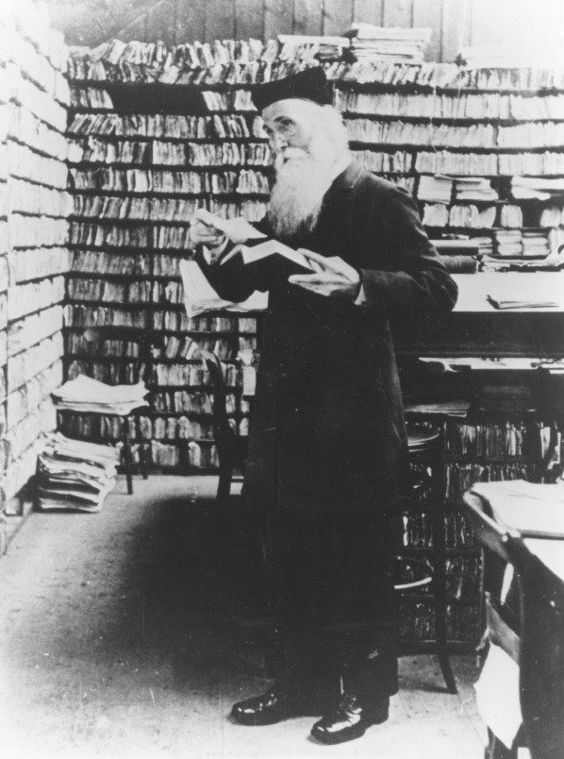
OUP dictionaries:
A tradition of public involvement

Slide 3
Mission Statement
Outline
Part 1 : Oxford Global Languages
The challenge
The response
Phase 1: The beginning …
Part 2 : Building the future
Developing the language content
Sustainable, flexible, and reusable data
Focus on usable outputs
Working with communities
Start small …
Partnerships– external and internal
Where we are and next steps

Slide 4
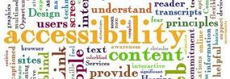
Oxford Global Languages
The challenge
Dominant languages
Disparate resources
Cultural attitudes
Technical challenges
Digital accessibility
Scattered initiatives
‘Top down’ approach

Slide 5
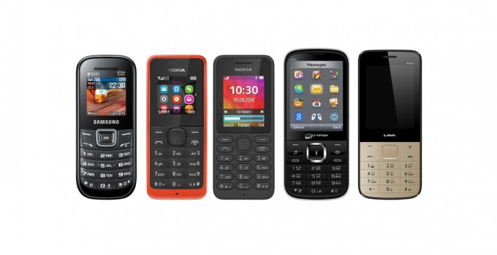
Oxford Global Languages
Further context
Demand for multilingual resources
Democratization of content
Increase in mobile
Global tech companies

Slide 6
Oxford Global Languages
The response
Focus on digitally under-represented languages
Develop content quickly
Inspire language communities
Make it social
Reusable content

Slide 7
Oxford Global Languages
Vision
Localized websites and digital access for 100+ languages
Language communities contributing content
Supporting digitally under-represented languages
Flexible data serving multiple needs

Slide 8
Oxford Global Languages
What it is not ….
An educational programme for schools
A research or academic unit
Focused on endangered languages
A government sponsored initiative
But we share a lot in common and can work together!

Slide 9
Oxford Global Languages
The beginning: Phase 1
October 2014-September 2016: Phase 1
Goals
11 language websites with 3-4 active communities
Complete workflow trialled and tested
Data models and platform able to store and update multilingual interlinked content
First usable outputs for third parties

Slide 10
Mission Statement
Outline
Part 1 : Oxford Global Languages
The challenge
The response
Phase 1: The beginning …
Part 2 : Building the future
Developing the language content
Sustainable, flexible, and reusable data
Focus on usable outputs
Working with communities
Start small …
Partnerships– external and internal
Where we are and next steps

Slide 11
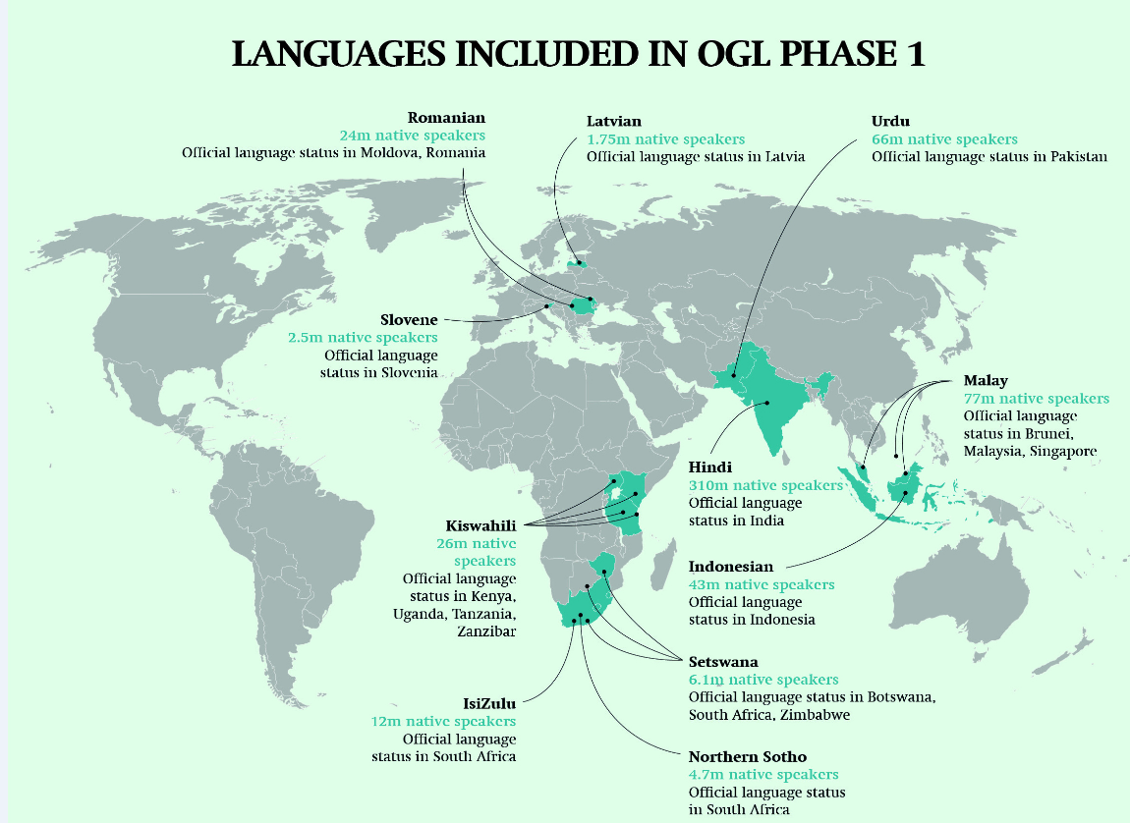
Phase 1: the first 10 (11!) languages
Hindi
Indonesian
IsiZulu
Kiswahili
Latvian
Malay
Northern Sotho
Romanian
Setswana
Slovene
Urdu

Slide 12
Building the future
Sustainable, flexible, and reusable data
LEAP
LEXICAL ENGINE AND PLATFORM
USES LINKED DATA, APIs, AND …

Slide 13
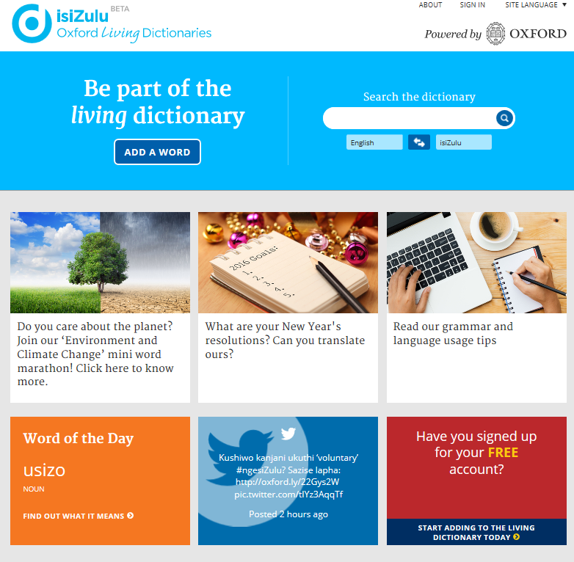
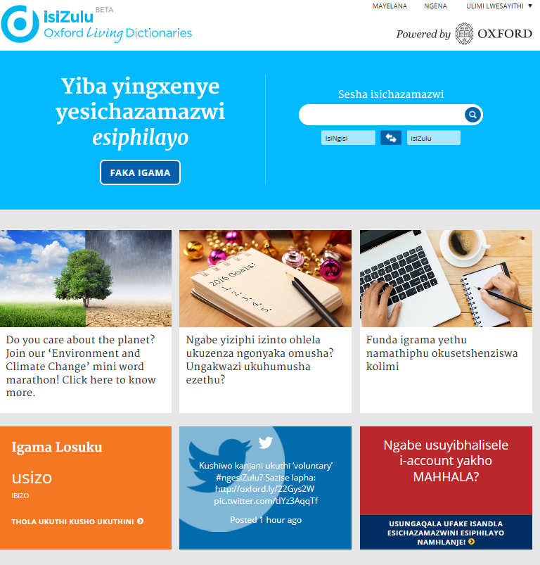
Building the future …
Focus on usable outputs …

Slide 14
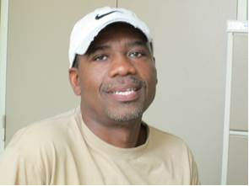
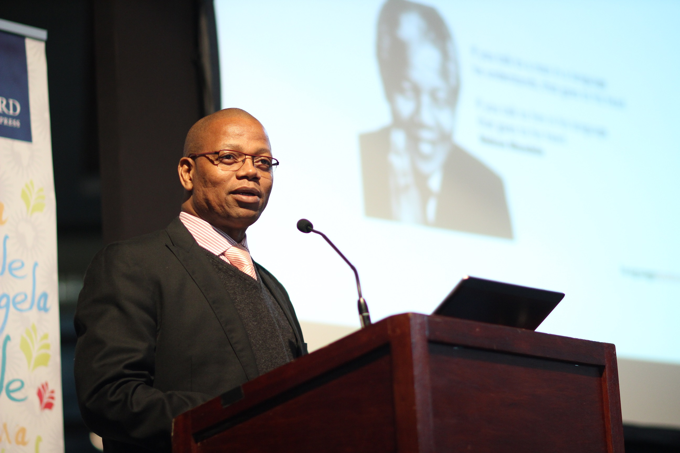
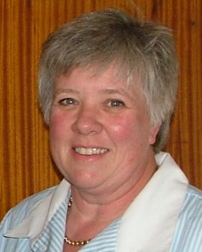
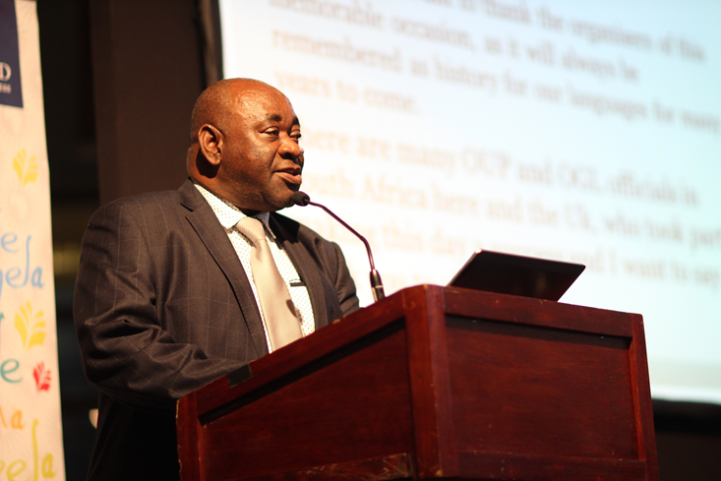
Building the future
Communities and the ‘living dictionary’
Sibusiso Dlamini
Langa Khumalo
Managed by and for the communities
Assisted by:
Language Managers, who oversee, moderate, and curate
Language Champions, who promote and advocate
Maropeng (Victor) Mojela
Elsabé Taljard
Language managers and champions for isiZulu and Northern Sotho pictured above. Also: Sonja Bosch, and Moroka Mamaile Ramaite

Slide 15
Building the future
Behind the ‘living dictionary’ communities
Community
Consume
Lexical information:
Definitions
Translations
Pronunciations
Grammar etc.
User
User
Contributor
Contribute
Lexical information:
Tools
Forum
Games
Forms
Contributor
Data Platform
CMS
Website
Language Champion
Language Champion
Editorial Tools
Input and output from DP
Moderate, validate & curate
Language Manager
Editor
Community Manager

Slide 16
Building the future
OUP Lexical Data
We have loads:
Dictionaries
Thesauri
Morphology
Usage examples
etc.

Slide 17
Building the future
Challenges
Data sets were siloed
Managing links was difficult
Current delivery by manual data dump

Slide 18
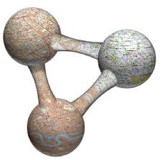
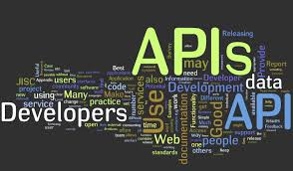
Building the future
OUP’s solution
Why?
Linked data
Scalable data integration
Graph model
Inferencing
API access
Tiered access
Usage analytics
Different views on the data

Slide 19
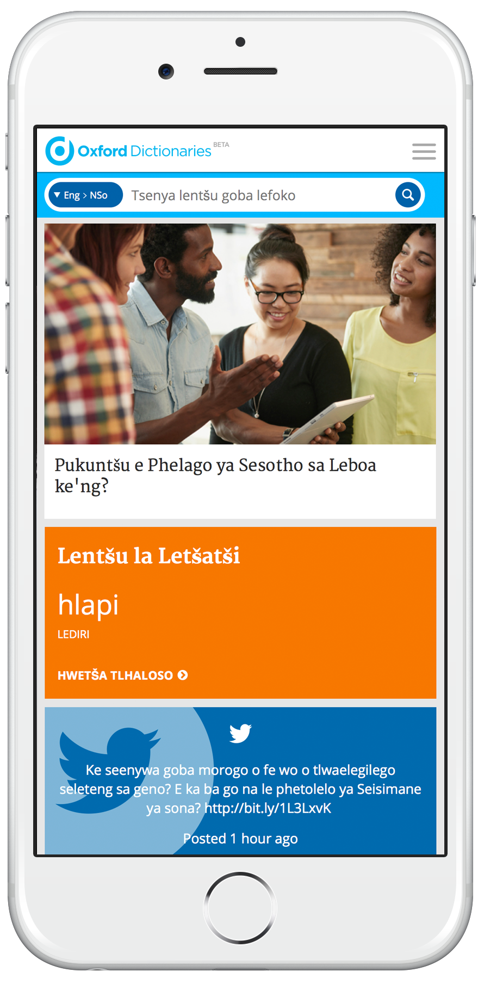
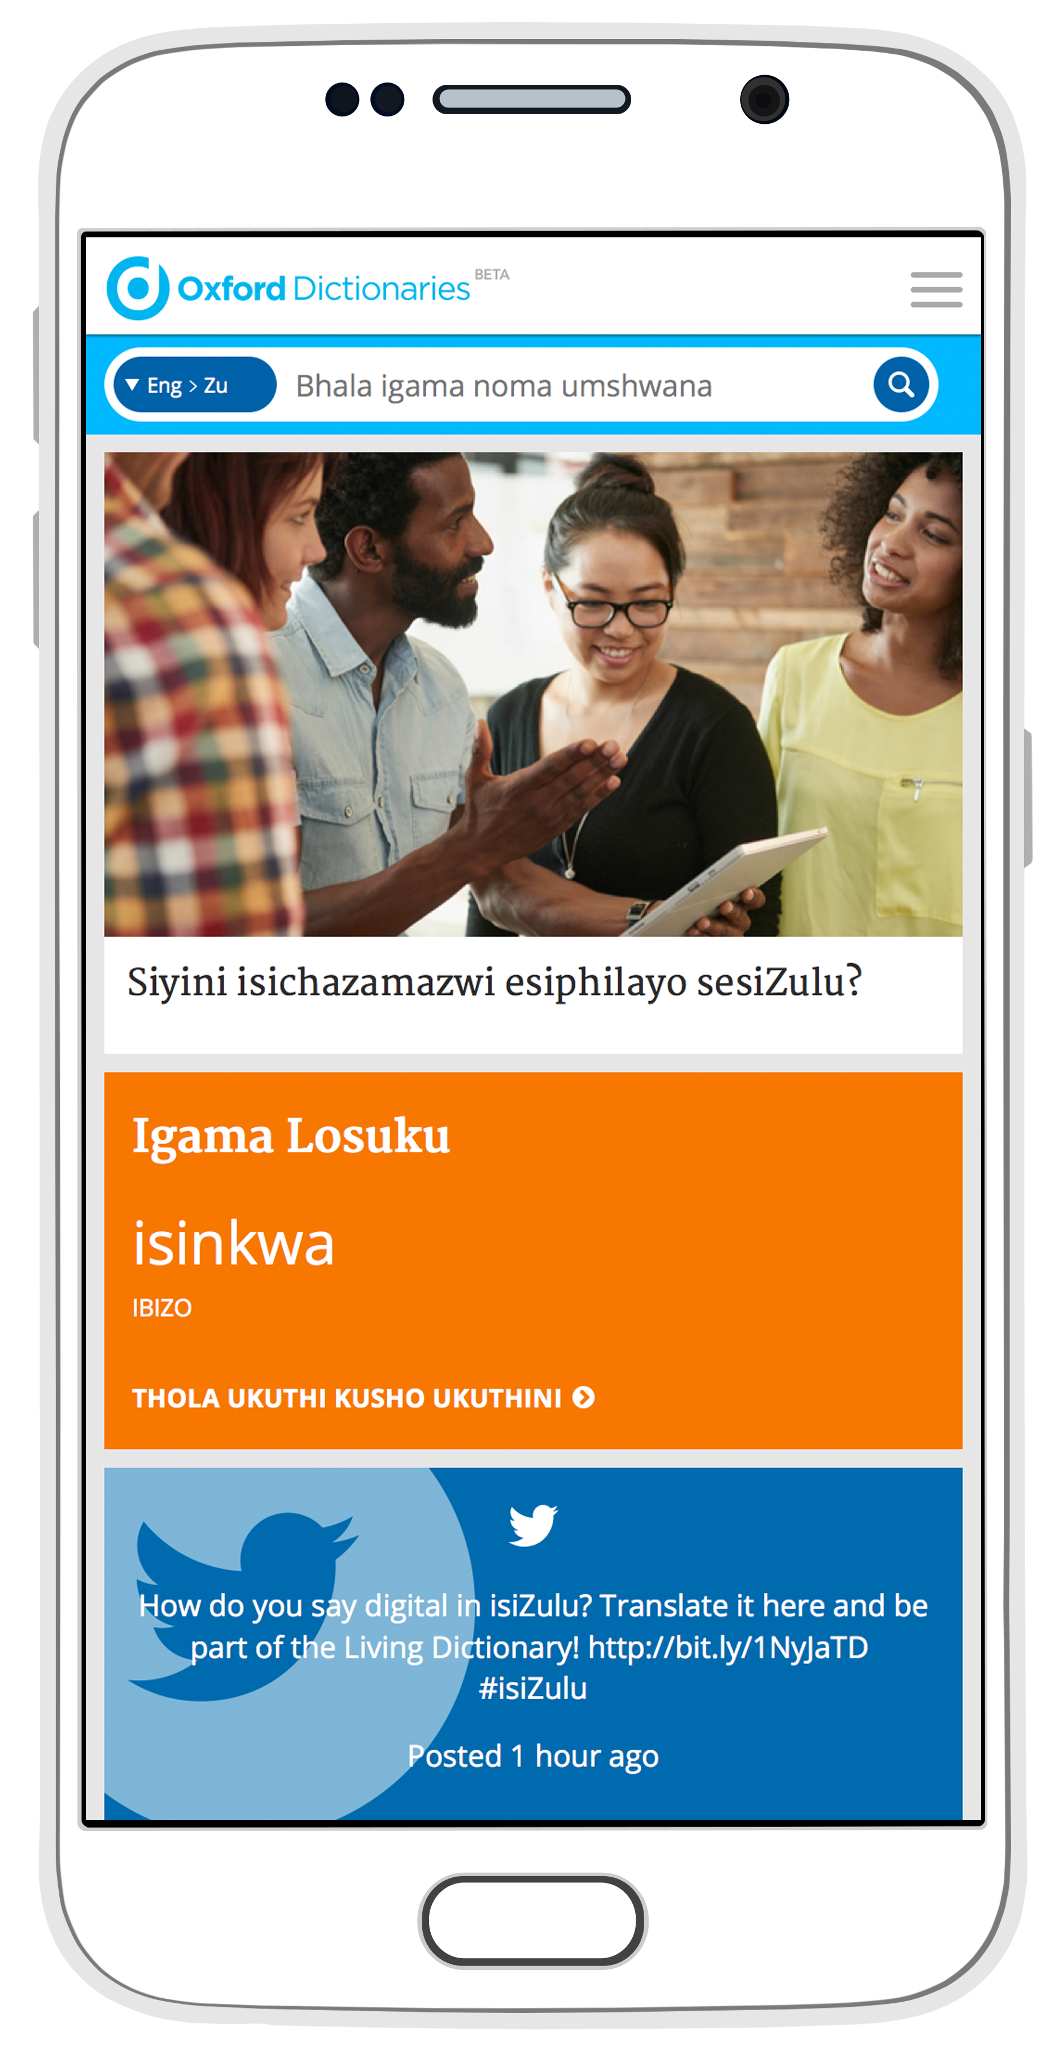
Building the future
Start small …
Experimental approach
Launch quickly
Focus on users
Partnerships
Start small and build!
https://nso.oxforddictionaries.com/
https://zu.oxforddictionaries.com/

Slide 20
Building the future
Partnerships – internal and external
Pool and test ideas
Share expertise
More collective resource
Move faster
Access to new markets
New business models

Slide 21
Mission Statement
Outline
Part 1 : Oxford Global Languages
The challenge
The response
Phase 1: The beginning …
Part 2 : Building the future
Developing the language content
Sustainable, flexible, and reusable data
Focus on usable outputs
Working with communities
Start small …
Partnerships– external and internal
Where we are and next steps

Slide 22
Where we are and next steps
Phase 1
Over half-way through Phase 1 and we are on track
Eleven languages in progress
Base technology of data platform in production
First two languages launched
Iterative website development
First communities are live!

Slide 23
Where we are and next steps
Phase 2 ….
Planning for Phase 2:
Many more languages and communities
Full digital accessibility
Outputs for developers and licensees
Many more strategic partnerships
Internal OUP synergies

Slide 24
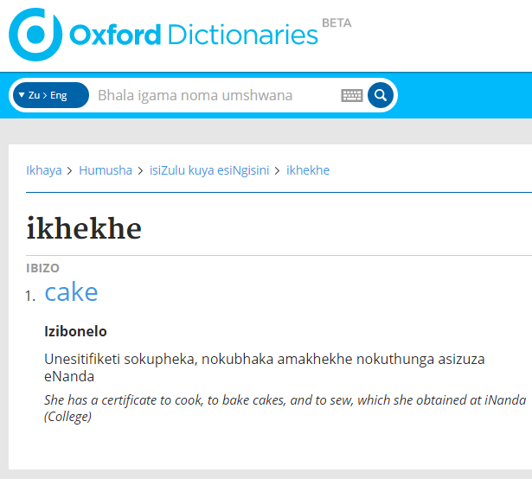
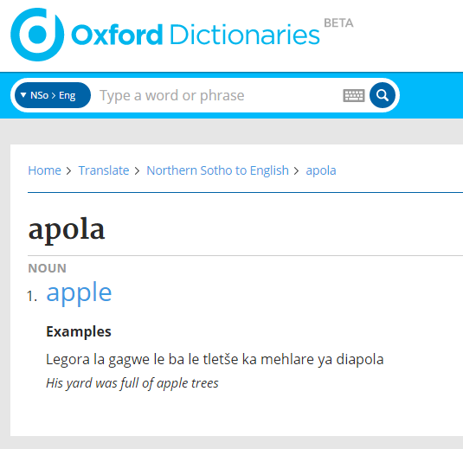
Where we are and next steps
OGL launched 2nd September 2015
https://zu.oxforddictionaries.com/
https://nso.oxforddictionaries.com/

Slide 25
Where we are and next steps
Proposed phase 2 initial languages
Language | Language family | Country | Speakers (L1)
Southern Quechua | Quechua | Bolivia and Peru | 6,000,000
Hausa | Chadic | Nigeria | 34,000,000
Amharic | Semitic | Ethiopia | 25,000,000
Czech | Slavic | Czech Republic | 10,000,000
Myanmar (Burmese) | Sino-Tibetan | Myanmar | 33,000,000
Mongolian | Mongolic | Mongolia | 5,700,000
Xhosa | Bantu | South Africa | 7,600,000
Vietnamese | Austro-Asiatic | Vietnam | 75,000,000
Afrikaans | Germanic | South Africa | 7,100,000
Chichewa | Bantu | Malawi and Zambia | 12,000,000
Turkish | Turkic | Turkey | 63,000,000
Hungarian | Uralic | Hungary | 13,000,000
Farsi/Persian | Iranian | Iran, Afghanistan, Tajikstan | 65,000,000
Javanese | Malayo-Polynesian | Java (Indonesia), Malaysia, Singapore | 82,000,000

Slide 26
Oxford Global Languages A defining project THANK YOU Jon French Advocacy and Partnerships Manager jon.french@oup.com

